Slide 1
Project meeting
IoT Group
2019.06.12

Slide 2
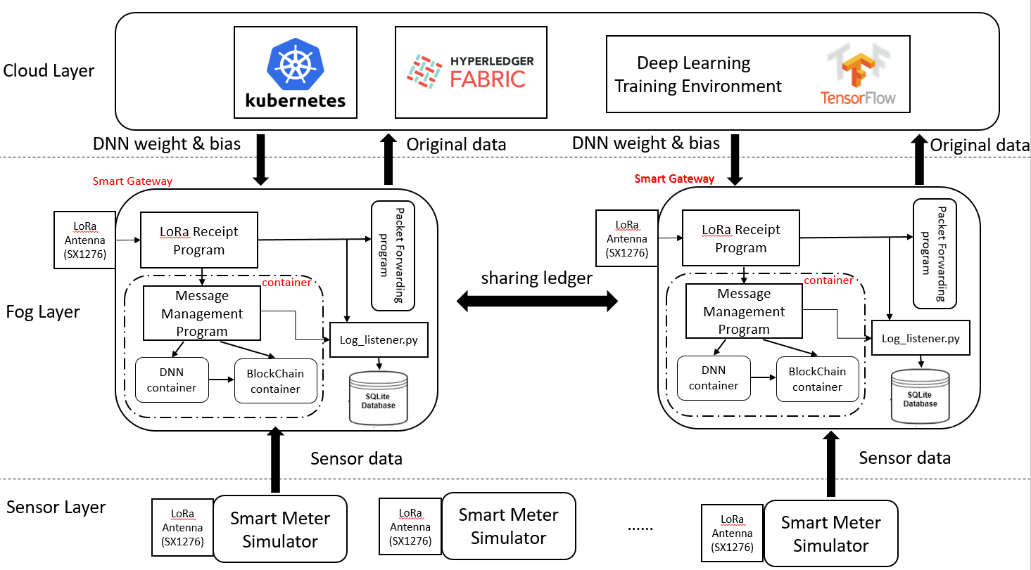
IoT Architecture

Slide 3
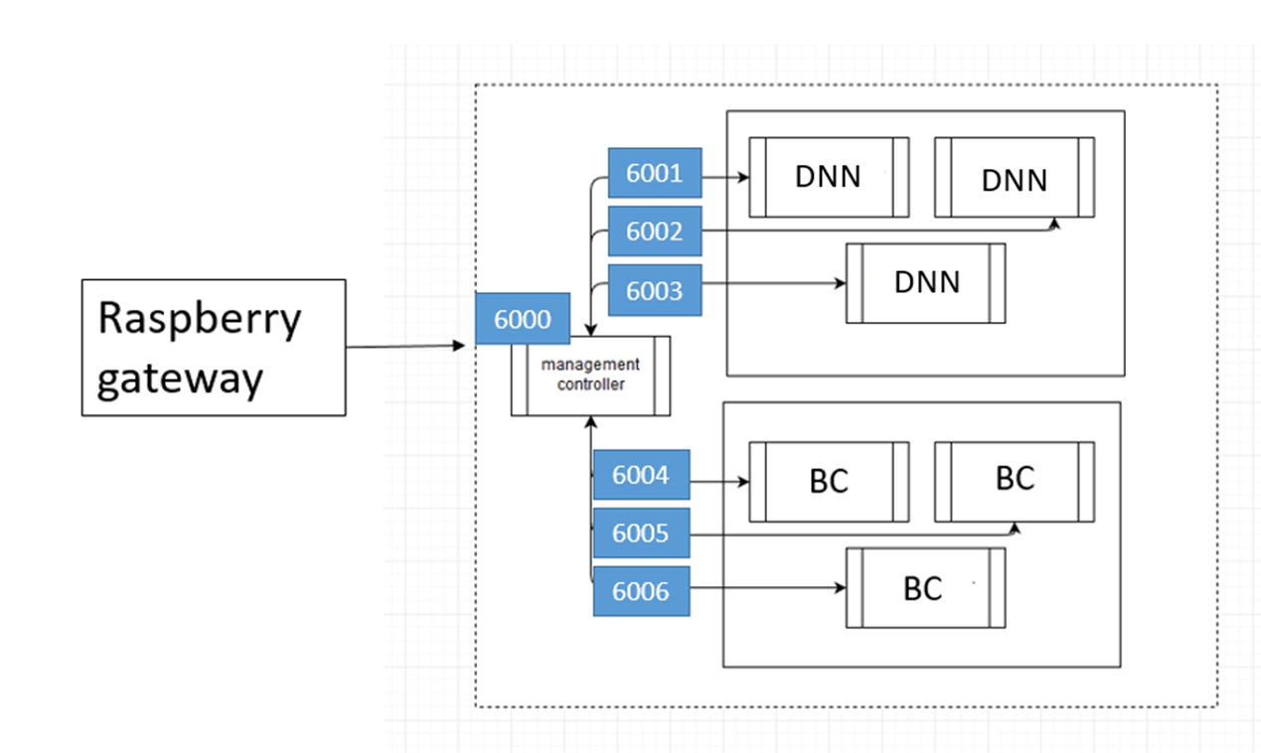
Docker Inner Network

Slide 4
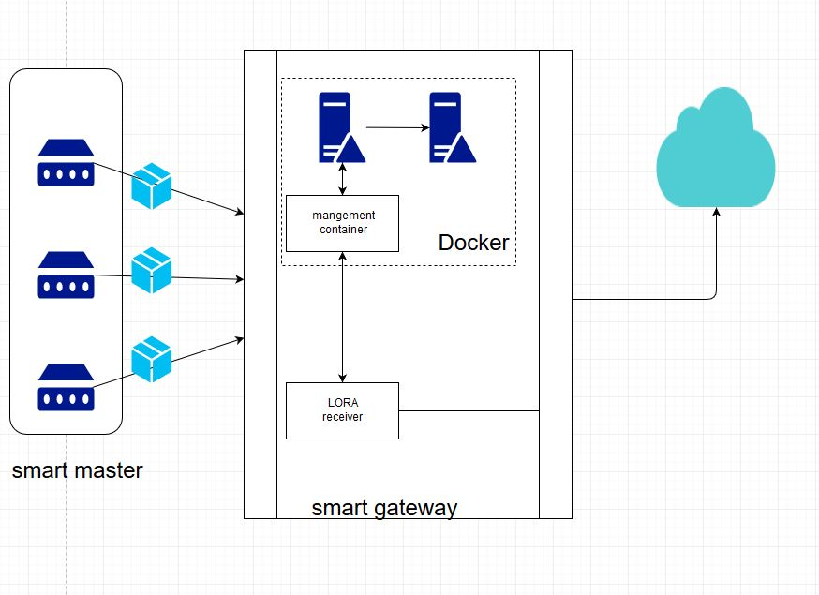
System architecture
Smart meter

Slide 5
System architecture
LoRaWAN
LoRa Sensor node ( Raspberry Pi 3 )
LoRa Gateway ( Raspberry Pi 3 )
LoRa
Antenna
(SX1276)
LoRa
Antenna
(SX1276)
LoRa receipt.py
LoRa transmission.py
Message
Management program
Smart meter
Simulator.py
DNN container
Smart meter Dataset.csv

Slide 6
System architecture of Buffer
Message Management
management
container
Buffer Rearder
Buffer
LORA Receiver

Slide 7
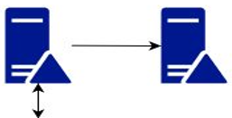
Receiver Buffer on Smart Gateway
Payload
Compare Payload ID
Space 1
Space 2
Payload 1
Payload 1
Payload 2
30min
200 smart meters
Payload 3
management
container
Docker
Buffer Reader
Message Management

Slide 8
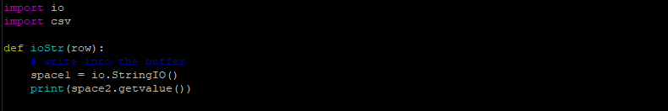
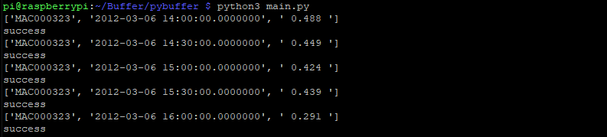
Program
String IO
Result of Test

Slide 9
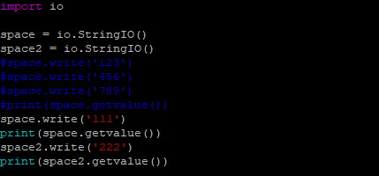

Problem
What is String IO ?
Why don’t I use Array?
Can I creat two String IO ?

Slide 10
System architecture

Slide 11
Buffer flow
Data_1
DNN
Data
Data_1
request
Data_2
DNN
Data_3
DNN
Mangement container

Slide 12
Input data flow
Input data
check array
Checking array[index] have same or not
check function
Index ++
Yes
No
Buffer_array
Push function

Slide 13
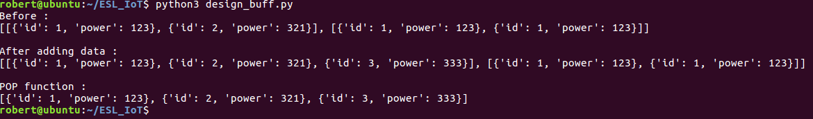
Buffer function
completed function:
search function
Pop function
Push function
check_buffer_size
show_buff
Will do function:
get_request_enter_container

Slide 14

Proposed Architecture for Log Data
Smart Gateway
LoRa Antenna
(SX1276)
LoRa Receipt
Program
Packet Forwarding program
container
Message
Management Program
Log_listener.py
DNN
container
BlockChain
container

Slide 15
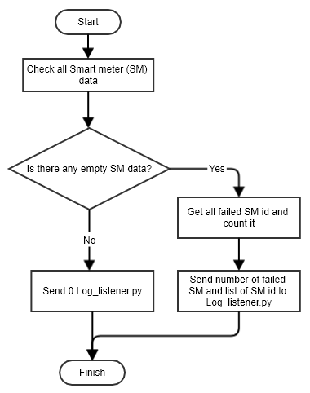
Flowchart for LoRa receiver log

Slide 16
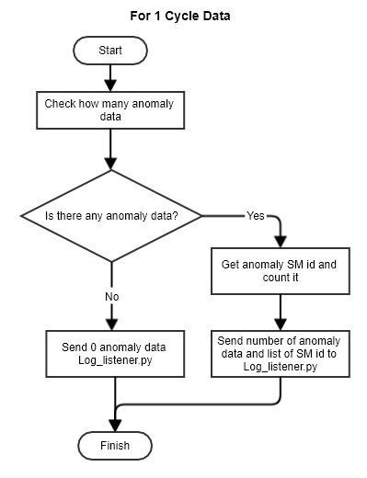
Flowchart for DNN log

Slide 17
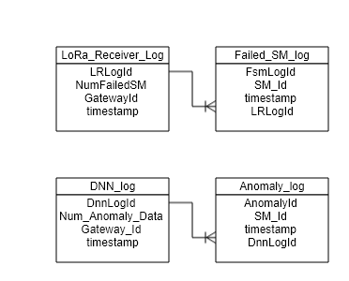
Database Design

